Slide 1
1.5 Fundamental Proof Techniques
1. Mathematical induction
Mathematical induction is a form of mathematical
proof.
Just because a rule, pattern, or formula seems to
work for several values of n, you cannot simply
decide that it is valid for all values of n without
going through a legitimate proof.

Slide 2
The Principle of Mathematical Induction
Let P_{n} be a statement involving the positive
integer n. If
P₁ is true, and
the truth of P_{k} implies the truth of P_{k+1} , for
every positive integer k,
then P_{n} must be true for all integers n.

Slide 3
Ex. Use mathematical induction to prove the following
formula.
S_{n} = 1 + 3 + 5 + 7 + . . . + (2n-1) = n²
First, we must show that the formula works for n = 1.
For n = 1
S₁ = 1 = 1²
The second part of mathematical induction has two
steps. The first step is to assume that the formula is
valid for some integer k. The second step is to use this
assumption to prove that the formula is valid for the
next integer, k + 1.
Assume S_{k} = 1 + 3 + 5 + 7 + . . . + (2k-1) = k²
is true, show that S_{k+1} = (k + 1)² is true.

Slide 4
S_{k+1} = 1 + 3 + 5 + 7 + . . . + (2k – 1) + [2(k + 1) – 1]
= [1 + 3 + 5 + 7 + . . . +(2k – 1)] + (2k + 2 – 1)
= S_{k} + (2k + 1)
= k² + 2k + 1
= (k + 1)²

Slide 5
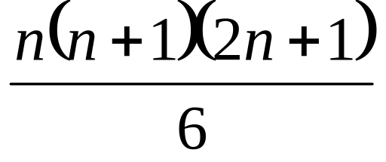
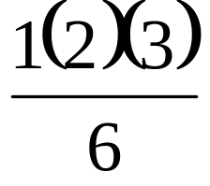
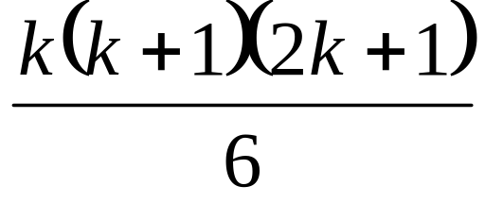
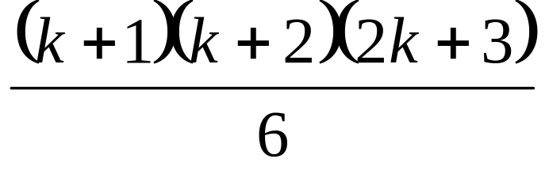
Ex. Use mathematical induction to prove the following formula.
S_{n} = 1² + 2² + 3² + 4² + . . . + n² =
1. Show n = 1 is true.
S_{n} = 1² =
2. Assume that S_{k} is true.
S_{k} =
1² + 2² + 3² + 4² + . . . + k² =
Show that S_{k+1} =
is true.

Slide 6
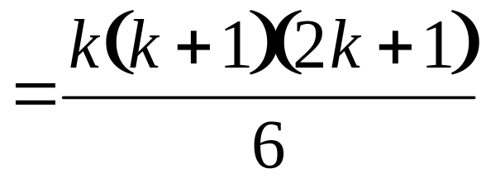
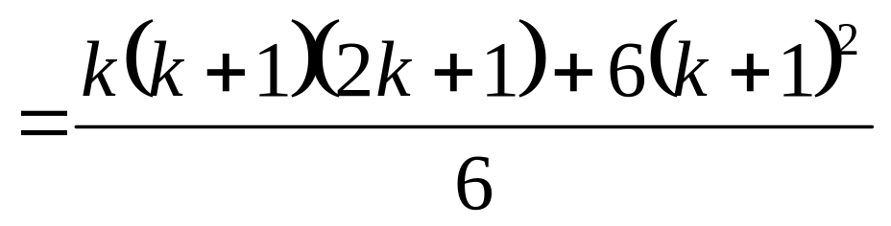
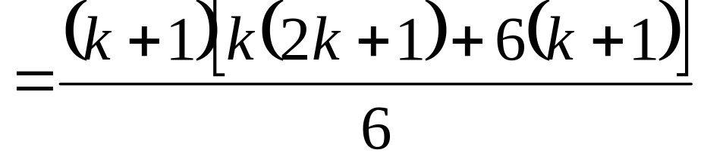
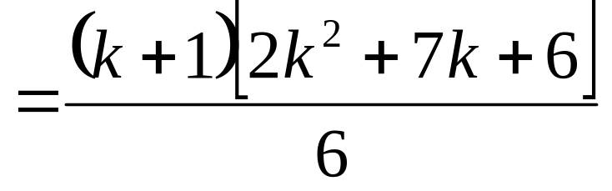
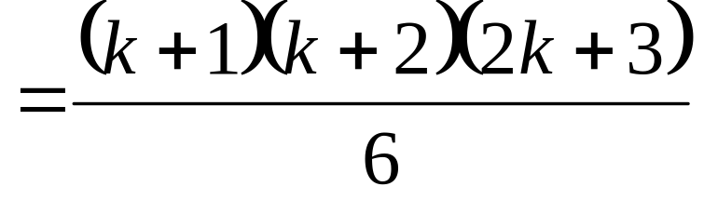
S_{k+1}
= (1² + 2² + 3² + 4² + . . . + k²) + (k + 1)²
+ (k + 1)²
Factor out a (k + 1)

Slide 7


1. Pigeonhole Principle
If (k+1) or more objects are placed into k boxes, then there is
at least one box containing two or more objects.
holes
objects
To prove this statement, let us suppose that each box contains
less than 2 objects; then the total number of objects would be
less than k, contradiction.

Slide 8

Problem 1
15 tourists tried to
hike the Washington
mountain. The oldest
of them is 33, while
the youngest one is
20. Prove that there
are 2 tourists of the
same age.

Slide 9
Problem 2
Wizard told Dorothy that he
would help her to get home, if
she could create a magic 6x6
square with entries either “+1”
or “-1”, so that all vertical,
horizontal and diagonal sums
would be different.
Prove that the Wizard cannot
help Dorothy, because there is
no such square.
-1 | 1 | 1 | 1 | 1 | -1
1 | -1 | 1 | 1 | -1 | 1
1 | 1 | -1 | -1 | 1 | 1
1 | 1 | -1 | -1 | 1 | 1
1 | -1 | 1 | 1 | -1 | 1
-1 | -1 | 1 | 1 | 1 | -1

Slide 10

Problem 3
The ocean covers
more than half of the
Earth surface. Can you
prove that there are two
points in the ocean which
are located on the exactly
opposite ends of an Earth
diameter?

Slide 11
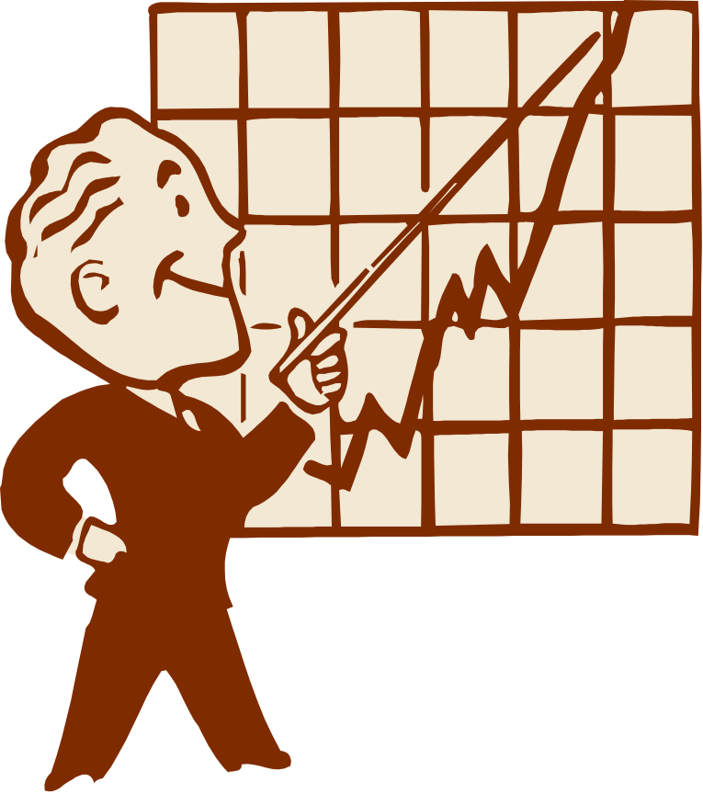
Problem 4
There are 30 students
in the classroom. Peter
got the worth results on a
test, and he made 13
mistakes. Can you prove
that there are at least 3
students who all made the
same number of mistakes
(not necessarily 13)?

Slide 12

Problem 5
John has 30 socks in a
box: 10 white, 10 red and
10 black. How many socks
must he pull out without
looking, in order to be
guaranteed to have:
1)two socks of the same color
2) two black socks
3) two different socks

Slide 13

Problem 6
There are 380
students at Magic school.
Prove that there are at
least two students whose
birthdays happen on a
same day.

Slide 14

Problem 7
There are 4,000,000,000
humans in our world
which are less than
100 years old. Prove that
there are at least two
persons that have been
born at the same second.

Slide 15
Problem 8
A student drew 12 not parallel lines on the sheet of paper.
Prove that there are at
least two lines that
make an angle of less
than 15 degrees with
one another.

Slide 16

Problem 9
A student has chosen
52 natural numbers.
Prove that you can choose
two from the list, so that
either their sum or their
difference would be
divisible by 100.

Slide 17

Problem 10
65 students wrote
three tests. The
possible grades are:
A, B, C and D.
Prove that there are
at least two of them
who managed to get
the same grades for all
three tests.

Slide 18
3. Diagonalization Principle
Main book: P.26

Slide 19
4. Inclusion-Exclusion Principle
Discrete Mathematics Key Notes

